Slide 1
Boko Haram
A Path to Reintegration
Jackson Institute, Yale University

Slide 2
Our Approach
Identify Strengths and Weaknesses
Applicability to Boko Haram
Analysis of Models
Recommendations

Slide 3
Models
Aceh, Indonesia
Sri Lanka
Colombia
South Africa
Somalia
Algeria
Mali
Niger Delta, Nigeria
Operation Safe Corridor, Nigeria
Environmental Factors: Lake Chad Basin Region

Slide 4
Insurgency | Lessons | Applicability
Sri Lanka
Insurgency: Sri Lankan Civil War
Sri Lankan Civil War lasted 25+ years
The LTTE (Liberation Tigers of Tamil Eelam) combatants rose up against the discrimination of the Tamil population by the government
Insurgency ended in defeat of the LTTE combatants by the government forces in 2009

Slide 5
Insurgency | Lessons | Applicability
Sri Lanka
Lessons Learned
Community and private company engagement can be employed to improve reintegration and lower costs
Relevance of punishment important for local population (controversy still relevant)
Recreational activities important for ex-combatants to be reintegrated
Difficult economic/employment situation makes reintegration efforts less effective

Slide 6
Insurgency | Lessons | Applicability
Sri Lanka
Applicability to Boko Haram
Similarities:
LTTE combatants took captive members of local population
Commitment of suicide attacks
Presence of child soldiers
Limited financial means to be able to afford rehabilitation program
Local (north-eastern) population was against reintegration of combatants
Differences:
Predominantly an ethnic conflict - disagreement of relevance of religion
Civil used terrorist strategies, but LTTEs were not (solely) a terror organization

Slide 7
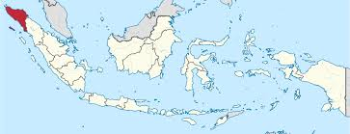
Insurgency | Lessons | Applicability
Aceh, Indonesia
Insurgency: Free Aceh Movement (GAM)
Driven by economic, cultural, and political grievances
Peace resolution spurred by the 2004 Indian Ocean tsunami that hit Aceh
Notes:
30 year conflict between GAM and GoI
Ended with 2004 tsunami and signing of Helsinki Memorandum of Understanding
Re-integration efforts focused on economic and political factors and less on social factors

Slide 8
Insurgency | Lessons | Applicability
Aceh, Indonesia
Lessons Learned
Difficulty of identifying former fighter and victim populations
Experimentation with community-based approaches
Criticism over the lack of a human rights or truth and reconciliation commission
Notes:
Difficulty identifying fighter and victim populations
Individual allocations -> community-based projects

Slide 9
Insurgency | Lessons | Applicability
Aceh, Indonesia
Applicability to Boko Haram
Similarities:
Widespread poverty
Military abuses
Oil
Religious aspect to insurgency
Differences:
Tsunami and resulting foreign aid
Political representation provided to GAM
Community acceptance of GAM and ex-fighters
Notes:
Tsunami
Widespread poverty & corruption
Military abuses - TRC
Political representation and community acceptance

Slide 10
Insurgency | Lessons | Applicability
Colombia
Insurgency: Revolutionary Armed Forces of Colombia - The People’s Army (FARC-EP)
Marxist guerrilla group formed in the 1960s as a political movement
Links to drug trade
Crimes against humanity on both sides (insurgency, government)
Finalized peace treaty with government in August 2016 but was defeated in a national referendum
Notes:
Insurgency description
Revolutionary Armed Forces of Colombia - The People’s Army (FARC-EP)
Marxist guerrilla group formed in the 1960s as a political movement, links to drug trade
Crimes against humanity on both sides (insurgency, government)
Finalized peace treaty with government in August 2016 but was defeated in a national referendum
Lessons learned
Important to survey local populations to see if they are ready for reconciliation and reintegration of ex-combatants
Potential importance for punishment as a condition for reintegration.
Applicability to Boko Haram
Reintegration of an insurgency that has been violently repressed by the government
Child soldiers, including women
Use of the development and environmental lenses as tools for peace-building

Slide 11
Insurgency | Lessons | Applicability
Colombia
Lessons Learned
Important to survey local populations to see if they are ready for reconciliation and reintegration of ex-combatants
Potential importance for punishment as a condition for reintegration

Slide 12
Insurgency | Lessons | Applicability
Colombia
Applicability to Boko Haram
Reintegration of an insurgency that has been violently repressed by the government
Child soldiers, including women
Use of the development and environmental lenses as tools for peace-building

Slide 13
Insurgency | Lessons | Applicability
South Africa
Insurgency: African National Congress (ANC)*
Began as peaceful movement representing victims of the apartheid system (Black Africans), who were denied civil and political rights, as well as subjected to inferior social services and living standards
Forced underground and violently repressed by ruling National Party - leading it to develop a militant arm (Umkhonto We Sizwe - Spear of the Nation)
Peaceful democratic transition spurred in early 1990s due to: economic decline (as a result of international sanctions/pressure); end of Cold War; NP presidential shift
Truth and Reconciliation Commission (TRC) established as a truth telling and conditional amnesty mechanism for reconstructing society
Notes:
Insurgency Description: African National Congress (ANC)*
Began as peaceful movement representing victims of the apartheid system (Black Africans), who were denied civil and political rights, as well as subjected to inferior social services and living standards
Forced underground and violently repressed by ruling National Party - leading it to develop a militant arm (Umkhonto We Sizwe - Spear of the Nation)
Peaceful democratic transition spurred in early 1990s due to: economic decline (as a result of international sanctions/pressure); end of Cold War; NP presidential shift
Truth and Reconciliation Commission (TRC) established as a truth telling and conditional amnesty mechanism for reconstructing society
Lessons Learned
Addressing Community vs. Individual Grievances: Rather than seeing apartheid as a system that acted against communities, only individual victims were acknowledged
Need for Appropriate Financial Planning: The TRC promised reparations to victims, but failed to deliver in a timely fashion (or to the level originally promised)
Challenge of Holding All Perpetrators Accountable: Only those who feared persecution applied for amnesty, leaving some perpetrators unpunished
Applicability to Boko Haram
Generally NOT an applicable model given: size & scale of apartheid; transition to democratic government; international support for and ultimate “victory” of the “insurgency” group
Potential components to be adapted:
Opportunity to bring multiple parties together in dialogue - Recognizing HR abuses committed by Nigerian military & BH
Conditional amnesty - No blanket amnesty, only amnesty for those who confess to acts committed for a clear political purpose. Punitive justice for worst atrocities.
Reparations - Opportunity to acknowledge community suffering and losses (particularly given smaller scale of conflict)

Slide 14
Insurgency | Lessons | Applicability
South Africa
Lessons Learned
Addressing Community vs. Individual Grievances: Rather than seeing apartheid as a system that acted against communities, only individual victims were acknowledged
Need for Appropriate Financial Planning: The TRC promised reparations to victims, but failed to deliver in a timely fashion (or to the level originally promised)
Challenge of Holding All Perpetrators Accountable: Only those who feared persecution applied for amnesty, leaving some perpetrators unpunished

Slide 15
Insurgency | Lessons | Applicability
South Africa
Applicability to Boko Haram
Generally NOT an applicable model given: size & scale of apartheid; transition to democratic government; international support for and ultimate “victory” of the “insurgency” group
Potential components to be adapted:
Opportunity to bring multiple parties together in dialogue - Recognizing HR abuses committed by Nigerian military & BH
Conditional amnesty - No blanket amnesty, only amnesty for those who confess to acts committed for a clear political purpose. Punitive justice for worst atrocities.
Reparations - Opportunity to acknowledge community suffering and losses (particularly given smaller scale of conflict)

Slide 16
Insurgency | Lessons | Applicability
Somalia
Insurgency: al-Shabaab
In 2006, the Islamic Courts Union (ICU) ousted the warlords that controlled Mogadishu and expanded its influence into other parts of southern Somalia
After Ethiopian troops defeated the ICU, al-Shabaab emerged as an autonomous insurgent force
Initially, popular support because of anger over the Ethiopian occupation and establishment of law and order, but lost support, as the militants forced their extreme interpretation of Islam
African Union peacekeepers backed Somali national army in its battle--insurgency remains ongoing
Notes:
Insurgency Description:
In 2006, the Islamic Courts Union (ICU) ousted the warlords that controlled Mogadishu and expanded its influence into other parts of southern Somalia.
After Ethiopian troops defeated the ICU, al-Shabaab emerged as an autonomous insurgent force.
Initially, the militants won some popular support because of anger over the Ethiopian occupation, and because they brought law and order to areas they controlled. However, as the militants enforced their extreme interpretation of Islam, they lost that support. At the same time, African Union peacekeepers arrived to back the Somali national army in its battle against the insurgents.
Lessons Learned:
Insurgency is ongoing, but sociologists have united around a reintegration approach for al-Shabaab combatants-- xeer.
Xeer, a dispute settlement mechanism based on clan/family customary law and elements of Sharia law, is the body of law derived from the Koran and from the teaching and examples of the Prophet Mohammed. The Xeer system is still the most commonly used and reinforced justice mechanism.
Applicability to Boko Haram:
Somalis use Xeer to solve perhaps 80-90% of all the controversies involving crimes, especially in rural areas where lack of transportation and tradition prevent people from using other justice mechanisms.
This may be applicable in a Nigerian context, especially in areas where Boko Haram soldiers have been recruited. The North is heavily Islamic, and perhaps xeer can be used after de-radicalized soldiers return.

Slide 17
Insurgency | Lessons | Applicability
Somalia
Lessons Learned
Sociologists have united around reintegration approach for al-Shabaab combatants-- xeer
Xeer, a dispute settlement mechanism based on clan/family customary law and elements of Sharia law
The body of law derived from the Qur’an and from the teaching and examples of the Prophet Mohammed
Xeer system is most commonly used and reinforced justice mechanism.

Slide 18
Insurgency | Lessons | Applicability
Somalia
Applicability to Boko Haram
Somalis use Xeer to solve perhaps 80-90% of all the controversies involving crimes, especially in rural areas where lack of transportation and tradition prevent people from using other justice mechanisms--much like state and community-based Nigeria
Conclusion: Applicable in Nigerian context, especially in areas where Boko Haram soldiers have been recruited, as the North is heavily Islamic
Especially relevant to populations who were forced into fighting--perhaps child soldiers, Chibok girls, etc.
Could end cycle of recruitment

Slide 19
Insurgency | Lessons | Applicability
Mali
Insurgency Description: Mouvement Nationale pour la Liberation de l’Azawad (MNLA)
Tuareg rebel group called the began attacks in Northern Mali in January 2012
Military coup in March 2012 and a military encounter with the rebels -> take-over by a loose coalition of jihadist groups (linked with Al-Qaeda) and the Tuareg rebels
Notable Jihadist Group: Ansar Dine and the Mouvement pour l’unicité et le Jihad en Afrique de l’Ouest (MUJAO)
Peace accord between rebel groups and the government was reached June 2015, but disarmament and reintegration is yet to happen
Notes:
Insurgency Description:Dissatisfied by marginalization of Northern Mali, a Tuareg rebel group called the Mouvement Nationale pour la Liberation de l’Azawad (MNLA) began attacks in Northern Mali in January 2012. A military coup in March 2012 and a military encounter with the rebels gave room for a take-over by a loose coalition of jihadist groups (linked with Al-Qaeda) and the Tuareg rebels. Notable among them were the Ansar Dine and the Mouvement pour l’unicité et le Jihad en Afrique de l’Ouest (MUJAO). A peace accord between rebel groups and the government was reached June 2015, but disarmament and reintegration is yet to happen.
Lessons Learned: Although Mali outlined expectations for DDR in the Accord pour la paix, no timetable or definition of success was established. Over a year after the peace agreement, Mali continues to experience violence and the civilian population is losing faith in the ability of the government to disarm rebels and maintain peace. Mali highlights the dangers of delay in initiating DDR.
Applicability to Boko Haram: If Nigeria is to negotiate a peace deal with Boko Haram, it should establish and follow a timetable for DDR.

Slide 20
Insurgency | Lessons | Applicability
Mali
Lessons Learned
Although Mali outlined expectations for DDR in the Accord pour la paix, no timetable or definition of success was established.
Mali continues to experience violence
The civilian population is losing faith in the ability of the government to disarm rebels and maintain peace
Dangers of delay in initiating DDR.

Slide 21
Insurgency | Lessons | Applicability
Mali
Applicability to Boko Haram
If Nigeria is to negotiate a peace deal with Boko Haram, it should establish and follow a timetable for DDR
To avoid continued armed conflict experienced by Mali, disarmament should occur early on
Mali has a geopolitical situation similar to that of Nigeria

Slide 22
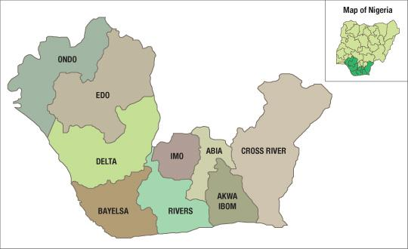
Insurgency | Lessons | Applicability
Nigeria – Niger Delta
Insurgency:
Political & Economic
Resource Control: Oil
Non-Religious

Slide 23
Insurgency | Lessons | Applicability
Nigeria – Niger Delta
Lessons Learned
Popular with Local Population
Cycle of demands from Unemployed Youths
No Guarantee

Slide 24
Insurgency | Lessons | Applicability
Nigeria – Niger Delta
Applicability to Boko Haram
Question of Amnesty
High costs of program need to be considered

Slide 25
Model | Lessons
Nigeria – Operation Safe Corridor
Model: Operation Safe Corridor
Goals:
Provide an alternative to fighting
Assist FGN in formalized DDR program
De-radicalization/trade training
Assist in ending hostilities in NE Nigeria

Slide 26
Model | Lessons
Nigeria – Operation Safe Corridor
Lessons Learned / Potential Problems
Military-run/location
Lack of community support
Not in conjunction with large-scale aid program
Lacks judicial process for prosecuting former militants

Slide 27
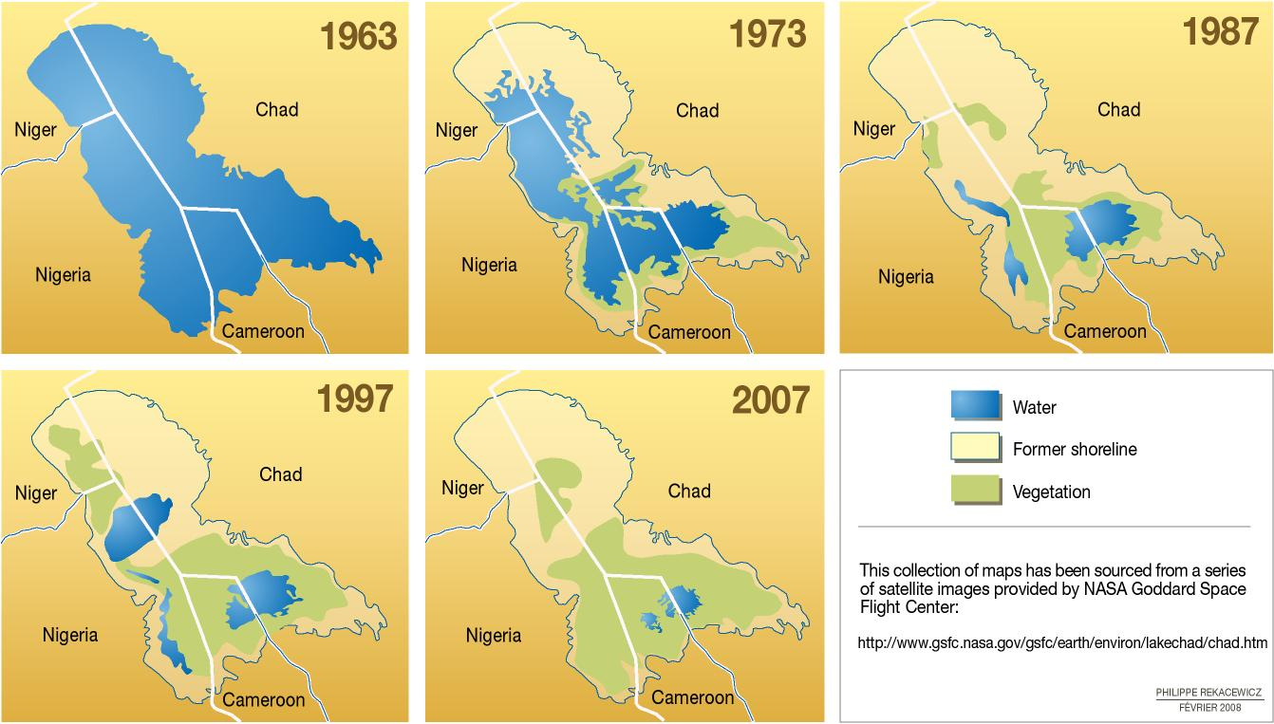
Lake Chad Basin
Environmental Analysis
A strategic transboundary resource - Cameroon, Chad, Nigeria and Niger
Climate change and unsustainable resource exploitation is shrinking the lake - drought, over-grazing, increasing population
LCBC - regulate use; manage conflict; lake restoration
Ecological security - human security - food security - IDPs - poverty
Geographic scope for rehabilitation/reintegration efforts.
Notes:
Environmental analysis -
A strategic transboundary resource - Cameroon, Chad, Nigeria and Niger
Climate change and unsustainable resource exploitation is shrinking the lake - drought, over-grazing, increasing population
LCBC - regulate use; manage conflict; lake restoration
Ecological security - human security - food security - IDPs - poverty
Geographic scope for rehabilitation/reintegration efforts

Slide 28
Lake Chad Basin
Climate Change and Extremism – implications of shrinking Lake Chad on radicalization
Climate change as a ‘threat multiplier’ - exacerbate risk factors
More unpredictability in climate patterns, which is impacting migration, infrastructural damage from extreme events, malnutrition, disease
Climate change also alters food supply through impacts on food production and tillable land availability
Relationship under exploration
Notes:
Links between climate change and extremism:
Climate change as a ‘threat multiplier’ - exacerbate risk factors
More unpredictability in climate patterns, which is impacting migration, infrastructural damage from extreme events, disease
Climate change also alters food supply through impacts on food production and tillable land availability
Relationship under exploration

Slide 29
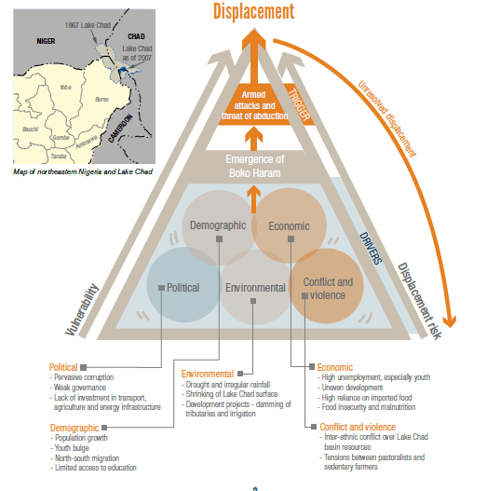
Notes:
http://www.internal-displacement.org/assets/publications/2015/20151208-root-causes-displacement.pdf

Slide 30
Questions
What are the US State Department’s objectives on Boko Haram? Does reintegration have a transitional justice component and what problems might that pose in northern Nigeria?
How do you see the situation with Boko Haram in light of your experiences in the foreign service?
How do you see the conflict with Boko Haram ending?
What resources does Nigeria need to bring Boko Haram and humanitarian crises to an end, and to reintegrate fighters?
Anything else we should consider when making our recommendations?

Slide 31
Thank You.
What Questions Do You Have?

Slide 32
Survey Questions
I would forgive former Boko Haram soldiers.
Should all Boko Haram insurgents be punished?
Should punishment be a condition for their return?
If a future opportunity arose to disarm and reintegrate Boko Haram fighters into your community, would you welcome it?
Would you support amnesty for Boko Haram
Would you welcome former Boko Haram into your community?
In addition to Boko Haram, do you believe that the Nigerian Military needs to be held accountable for its actions against civilians?
How strongly do you agree with the following statement: I would accept Boko Haram combatants back into my village, if ,my community received we receive monetary support to do so.
Do you agree or disagree - No Boko Haram fighter should be reintegrated into society until all the Chibok girls are returned.
Do you agree or disagree - Someone in my family was killed or injured by Boko Haram.

Slide 33
Insurgency | Lessons | Applicability
Algeria
Insurgency: Islamic Salvation Front (FIS)
Split of the Algerian Liberation Front (FLN), the ruling and only party, into Arab secularists (mostly military elite) and Reform Islamists during the 1970s-1980s.
Reform Islamists, FIS, used pubic appeal to gain political power for the purposes of revising social justice, redistributing political power from the uniparty system.
In 1989, FLN leadership allowed for increased political participation. FIS gained a vast majority of seats in the 1991 municipal and general elections, in response to this threat the FLN military seized power, cancelled election results, and brutally suppressed the FIS. FIS militant groups and other Islamic splinter groups responded with violence against government forces and civilian populace.
2006 Referendum: The Charter for Peace and National Reconciliation created amnesty for terrorist groups and governmental forces, with exclusions for individuals that committed rape, set off explosives in public places, or carried out assassinations.
Notes:
Conflict Description: Islamic Salvation Front (FIS)
Conflict was a result of a split of the Algerian Liberation Front (FLN), the ruling and only party, into Arab secularists (mostly military elite) and Reform Islamists during the 1970s-1980s.Reform Islamists, FIS, used pubic appeal to gain political power for the purposes of revising social justice, redistributing political power from the uniparty system.
In 1989, FLN leadership allowed for increased political participation. FIS gained a vast majority of seats in the 1991 municipal and general elections, in response to this threat the FLN military seized power, cancelled election results, and brutally suppressed the FIS. FIS militant groups and other Islamic splinter groups responded with violence against government forces and civilian populace.
2006 Referendum: The Charter for Peace and National Reconciliation created amnesty for terrorist groups and governmental forces, with exclusions for individuals that committed rape, set off explosives in public places, or carried out assassinations.
Lessons Learned
National Reconciliation was a method to the RESET the country with additional political concessions to Islamic traditionalists. This form of reconciliation did not lead to the creation of additional institutions. Current governmental institutions were utilized to support incentives and transitional justice as required.
National classification of the conflict as a ‘Civil War’ instead of an insurgency supported an international strategic message for support and set the conditions to issue national reconciliation. This implies the national government’s recognition of wrongdoing.
Reconciliation was offered from a position of Government strength. FIS and splinter groups were weakened but able to continue a protracted struggle. This indicates after a protracted defeat campaign, national reconciliation is a path to conflict termination.
Applicability to Boko Haram
Generally NOT an applicable model given the scope, conflict classification, and method to conclude the conflict. However, the use of a national reconciliation referendum could prove as an acceptable way to absolve government and insurgent forces while simultaneously appealing to the victims of the conflict.
The drivers of the Algerian Civil War are remarkably similar to the drivers of the Nigeria Boko Haram conflict. Understanding and recognizing these drivers would provide extensive value to stable country.

Slide 34
Insurgency | Lessons | Applicability
Algeria
Lessons Learned
National Reconciliation was a method to the RESET the country with additional political concessions to Islamic traditionalists. This form of reconciliation did not lead to the creation of additional institutions. Current governmental institutions were utilized to support incentives and transitional justice as required.
National classification of the conflict as a ‘Civil War’ instead of an insurgency supported an international strategic message for support and set the conditions to issue national reconciliation. This implies the national government’s recognition of wrongdoing.
Reconciliation was offered from a position of Government strength. FIS and splinter groups were weakened but able to continue a protracted struggle. This indicates after a protracted defeat campaign, national reconciliation is a path to conflict termination.

Slide 35
Insurgency | Lessons | Applicability
Algeria
Applicability to Boko Haram
Similarities: Drivers of the conflict
Poverty
Religion
Marginalization by government
Conclusion: Generally NOT an applicable model given the scope, conflict classification, and method to conclude the conflict.
Recommend: National reconciliation referendum could be useful instrument
Notes:
National reconciliation referendum could prove as an acceptable way to absolve government and insurgent forces while simultaneously appealing to the victims of the conflict.

